Slide 1
Machine Learning and Data Preprocessing
Dept. of Astronomy, Space Science
Chungnam National University
Yeji Jo

Slide 2
Artificial Intelligence
The branch of computer science that develops machines and software with human-like intelligence.
The study of the design of intelligent agents, where an intelligent agent is a system that perceives its environment and takes actions that maximize its chances of success.

Slide 3
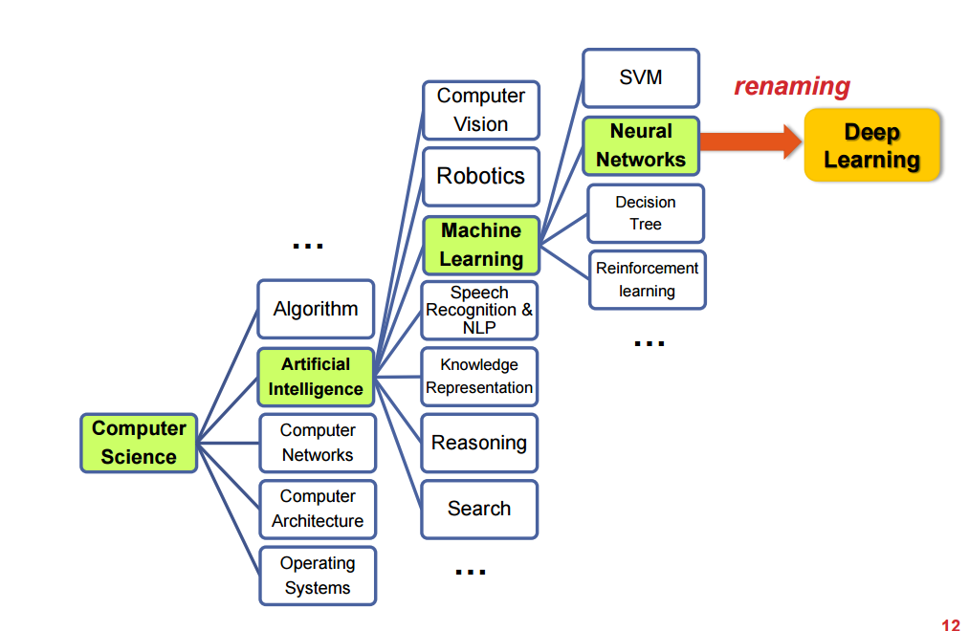
Artificial Intelligence

Slide 4
Machine Learning
A computer program is said to learn from experience E with respect to some class of tasks T and performance measure P, if its performance at tasks in T, as measured by P, improbes with experience E. (Tom Mitchell,1997)

Slide 5
Machine Learning
Supervised Learning
Classfication
Regression
Unsupervised Learning
Clustering
Reinforcement Learning

Slide 6


Supervised Learning
Regression
Hypothesis
$h_{θ}(x)$ $=$ $θ_{0}x+θ_{1}x_{1}$
Mean Square Error
MSE $=$ $\frac{1}{m}\sum_{i=1}^{m}{{(h_{θ}(x^{i})−y^{i})}^{2}}$
Loss Function (Cost Function)
$$J\left(θ\right)=\frac{1}{2m}\sum_{i=1}^{m}{{(h_{θ}(x^{i})−y^{i})}^{2}}$$
Gradient Descent
$− ∇J\left(θ\right)$
$θ_{0}$ = $θ_{0}−α\frac{∂}{∂θ_{0}}J(θ_{0}$,$θ_{1})$
$θ_{1}$ = $θ_{1}−α\frac{∂}{∂θ_{1}}J(θ_{0}$,$θ_{1})$

Slide 7
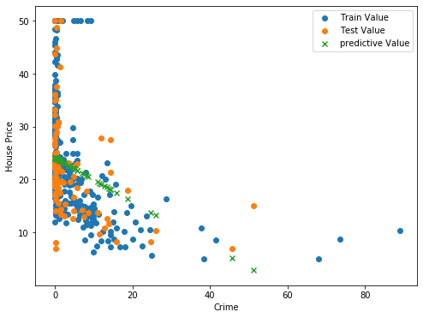
Supervised Learning
Regression
Linear Regression
Multiple Linear Regression
Polynomial Regression
Number of Training Data : 404
MSE = 8.180697228317348

Slide 8
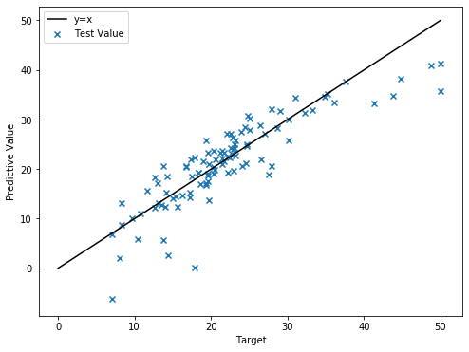
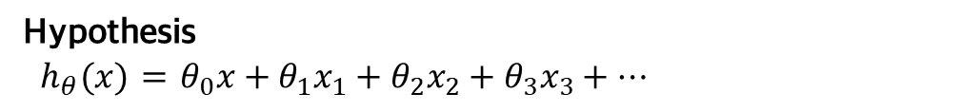
Supervised Learning
Regression
Linear Regression
Multiple Linear Regression
Polynomial Regression
Hypothesis
${ h}_{θ}(x)$ $=$ $θ_{0}x+θ_{1}x_{1}+θ_{2}x_{2}+θ_{3}x_{3}+⋯$
13 features
MSE = 4.568292042308995

Slide 9
Supervised Learning
Regression
Linear Regression
Multiple Linear Regression
Polynomial Regression
Hypothesis of 2D
${ h}_{θ}(x)$ $=$ $θ_{0}x+θ_{1}x_{1}+θ_{2}x_{2}+θ_{3}x_{3}+θ_{4}x_{1}x_{2}+θ_{5}x_{2}x_{3}+θ_{6}x_{3}x_{1}+θ_{7}x_{1}^{2}+θ_{8}x_{2}^{2}+θ_{9}x_{3}^{2}$

Slide 10
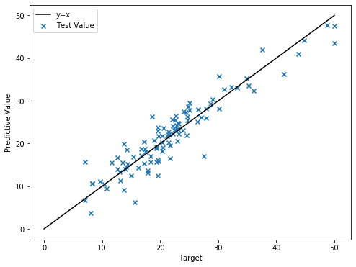
Supervised Learning
Regression
Linear Regression
Multiple Linear Regression
Polynomial Regression
13 features
MSE = 3.196527651029749

Slide 11
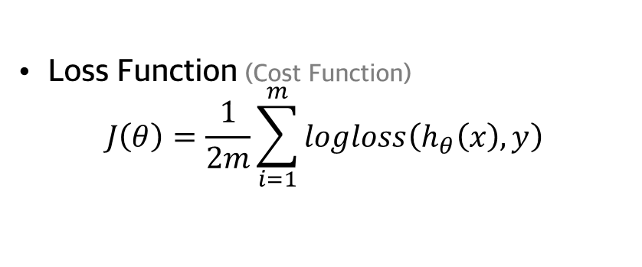
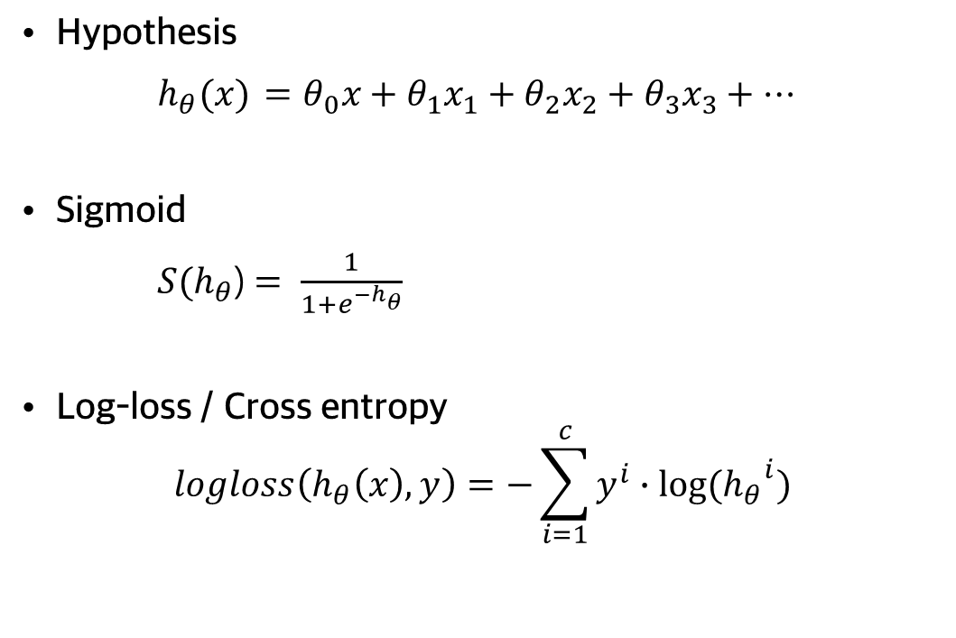
Supervised Learning
Classification
Logistic Regression
Hypothesis
$h_{θ}(x)$ $=θ_{0}x+θ_{1}x_{1}+θ_{2}x_{2}+θ_{3}x_{3}+⋯$
Sigmoid
$S(h_{θ}$)$= \frac{1}{1+e^{−h_{θ}}}$
Log-loss / Cross entropy
$$logloss\left(h_{θ}\left(x\right),y\right)=−\sum_{i=1}^{c}{y^{i}∙log⁡({h_{θ}}^{i})}$$
Loss Function (Cost Function)
$$J\left(θ\right)=\frac{1}{2m}\sum_{i=1}^{m}{logloss\left(h_{θ}\left(x\right),y\right)}$$

Slide 12
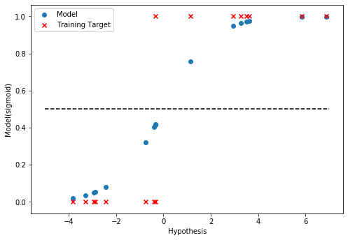
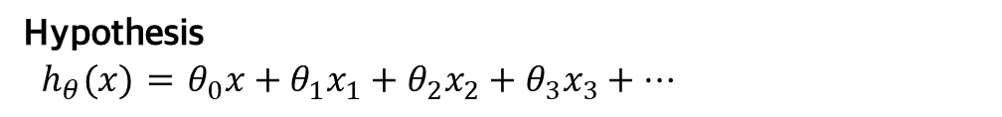
Supervised Learning
Classification
Logistic Regression
Hypothesis
${ h}_{θ}(x)$ $=$ $θ_{0}x+θ_{1}x_{1}+θ_{2}x_{2}+θ_{3}x_{3}+⋯$
Number of Data : 16
Class : 2

Slide 13
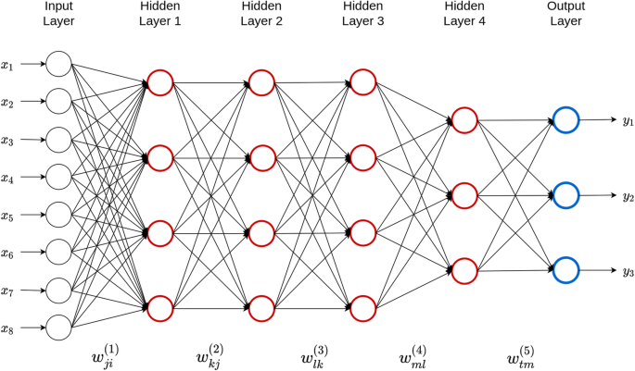
Deep Learning Artificial neural network

Slide 14
Project
Song Perception
Data Processing
Distinguish between noise and song using CNN
Finding a song
Creating a destructive interference wave
Noise canceling for songs

Slide 15
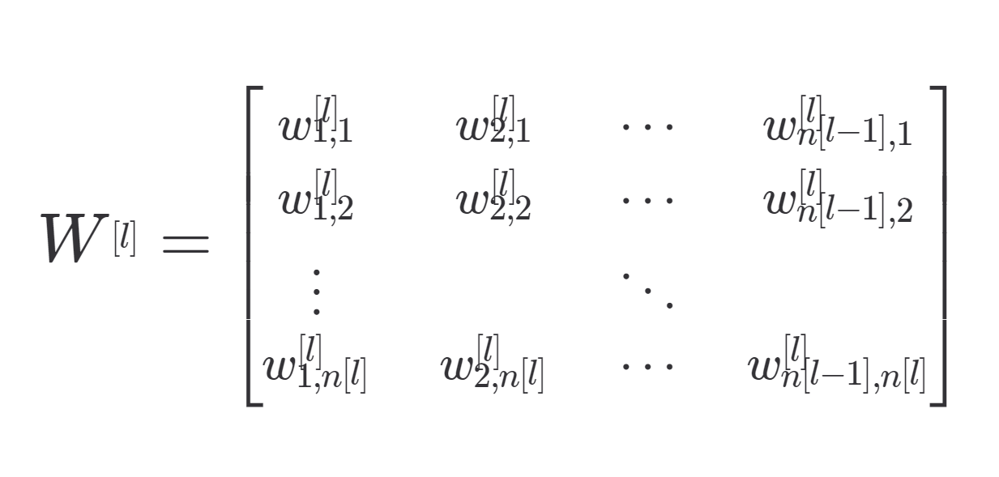


Project
$n^{(l)}=$number of data in (l) layer
Number of input : 16000
$$w^{1}=(16000,n^{\left(1\right)})$$

Slide 16
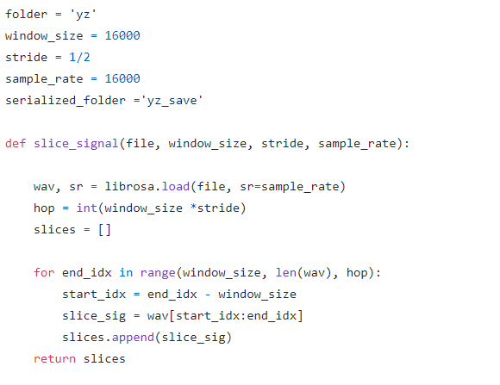

Project
$slices_{size}=(\frac{len\left(wav\right)}{hop}−1, window_size$)

Slide 17
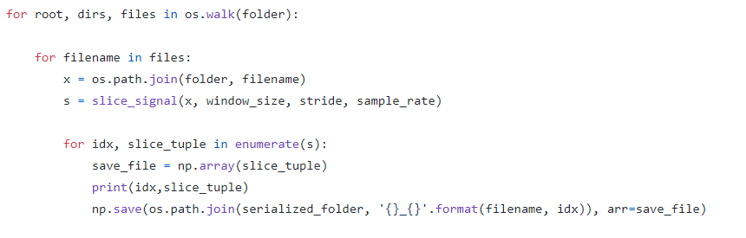
Project

